Slide 1
603 Alpha Gen
Group 11
CAI YIHAN, CHEN LIANGRUI, NADEZHDA KHUSNETDINOVA, TOM TAN ZE JIE, WANG HAOTONG, XIA TIAN, YU LINGFENG

Slide 2

Contents at a glance
Intro & Assumptions
Methodology and Asset selection
Momentum
Ichimoku
CCI
Mean Reversion
TP
TS
SSB
Results
Discussion & future developments

Slide 3

Introduction
Alpha generation – generation of excess returns
Our goal: development and backtest of a strategy, that would generate higher returns than the market
Our methods: technical analysis tools and indicators (a theory driven approach)

Slide 4

Underlying data
Three stock markets - China, the U.S. and Singapore
Dividend and non-dividend stocks analyzed separately
The suitability of our model for different sectors in different stock markets was assessed
As a result we established a relationship between strategy and market returns
Assumption:
Theory driven technical analysis (momentum and mean reversion, as well as the indicators used) is a relevant choice of strategy.

Slide 5
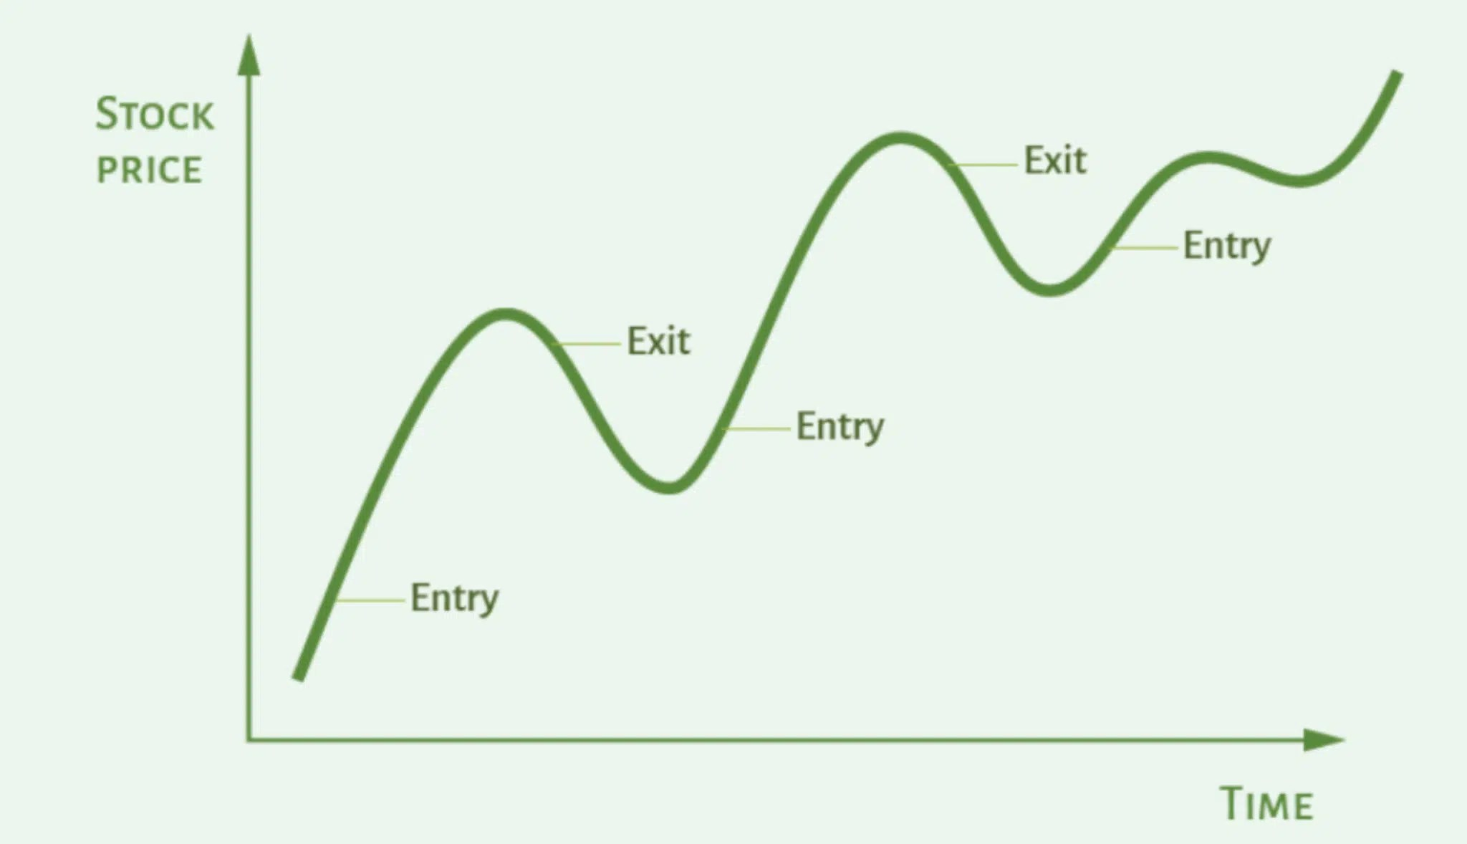
Momentum
Following the market trend
High performing stocks will continue to rise, so we'd want to buy them
Low performing stocks will further fall, so we sell
As momentum indicators we have chosen CCI and Ichimoku
Assumption:
momentum strategy has net predictive power for some stocks

Slide 6
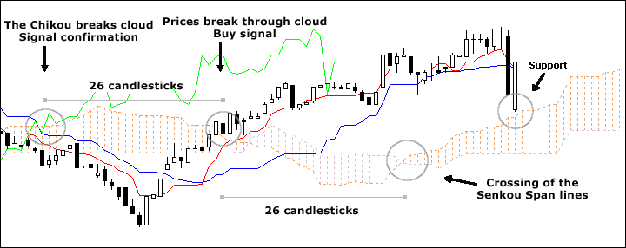
Ichimoku Cloud
a collection of technical indicators that show support and resistance levels, as well as momentum and trend direction
It comprises of 9d avg, 26d avg, avg of these two averages, 52d avg and a lagging close price line
The color and position of the cloud relative to the price chart provides information on the direction of the trend.

Slide 7
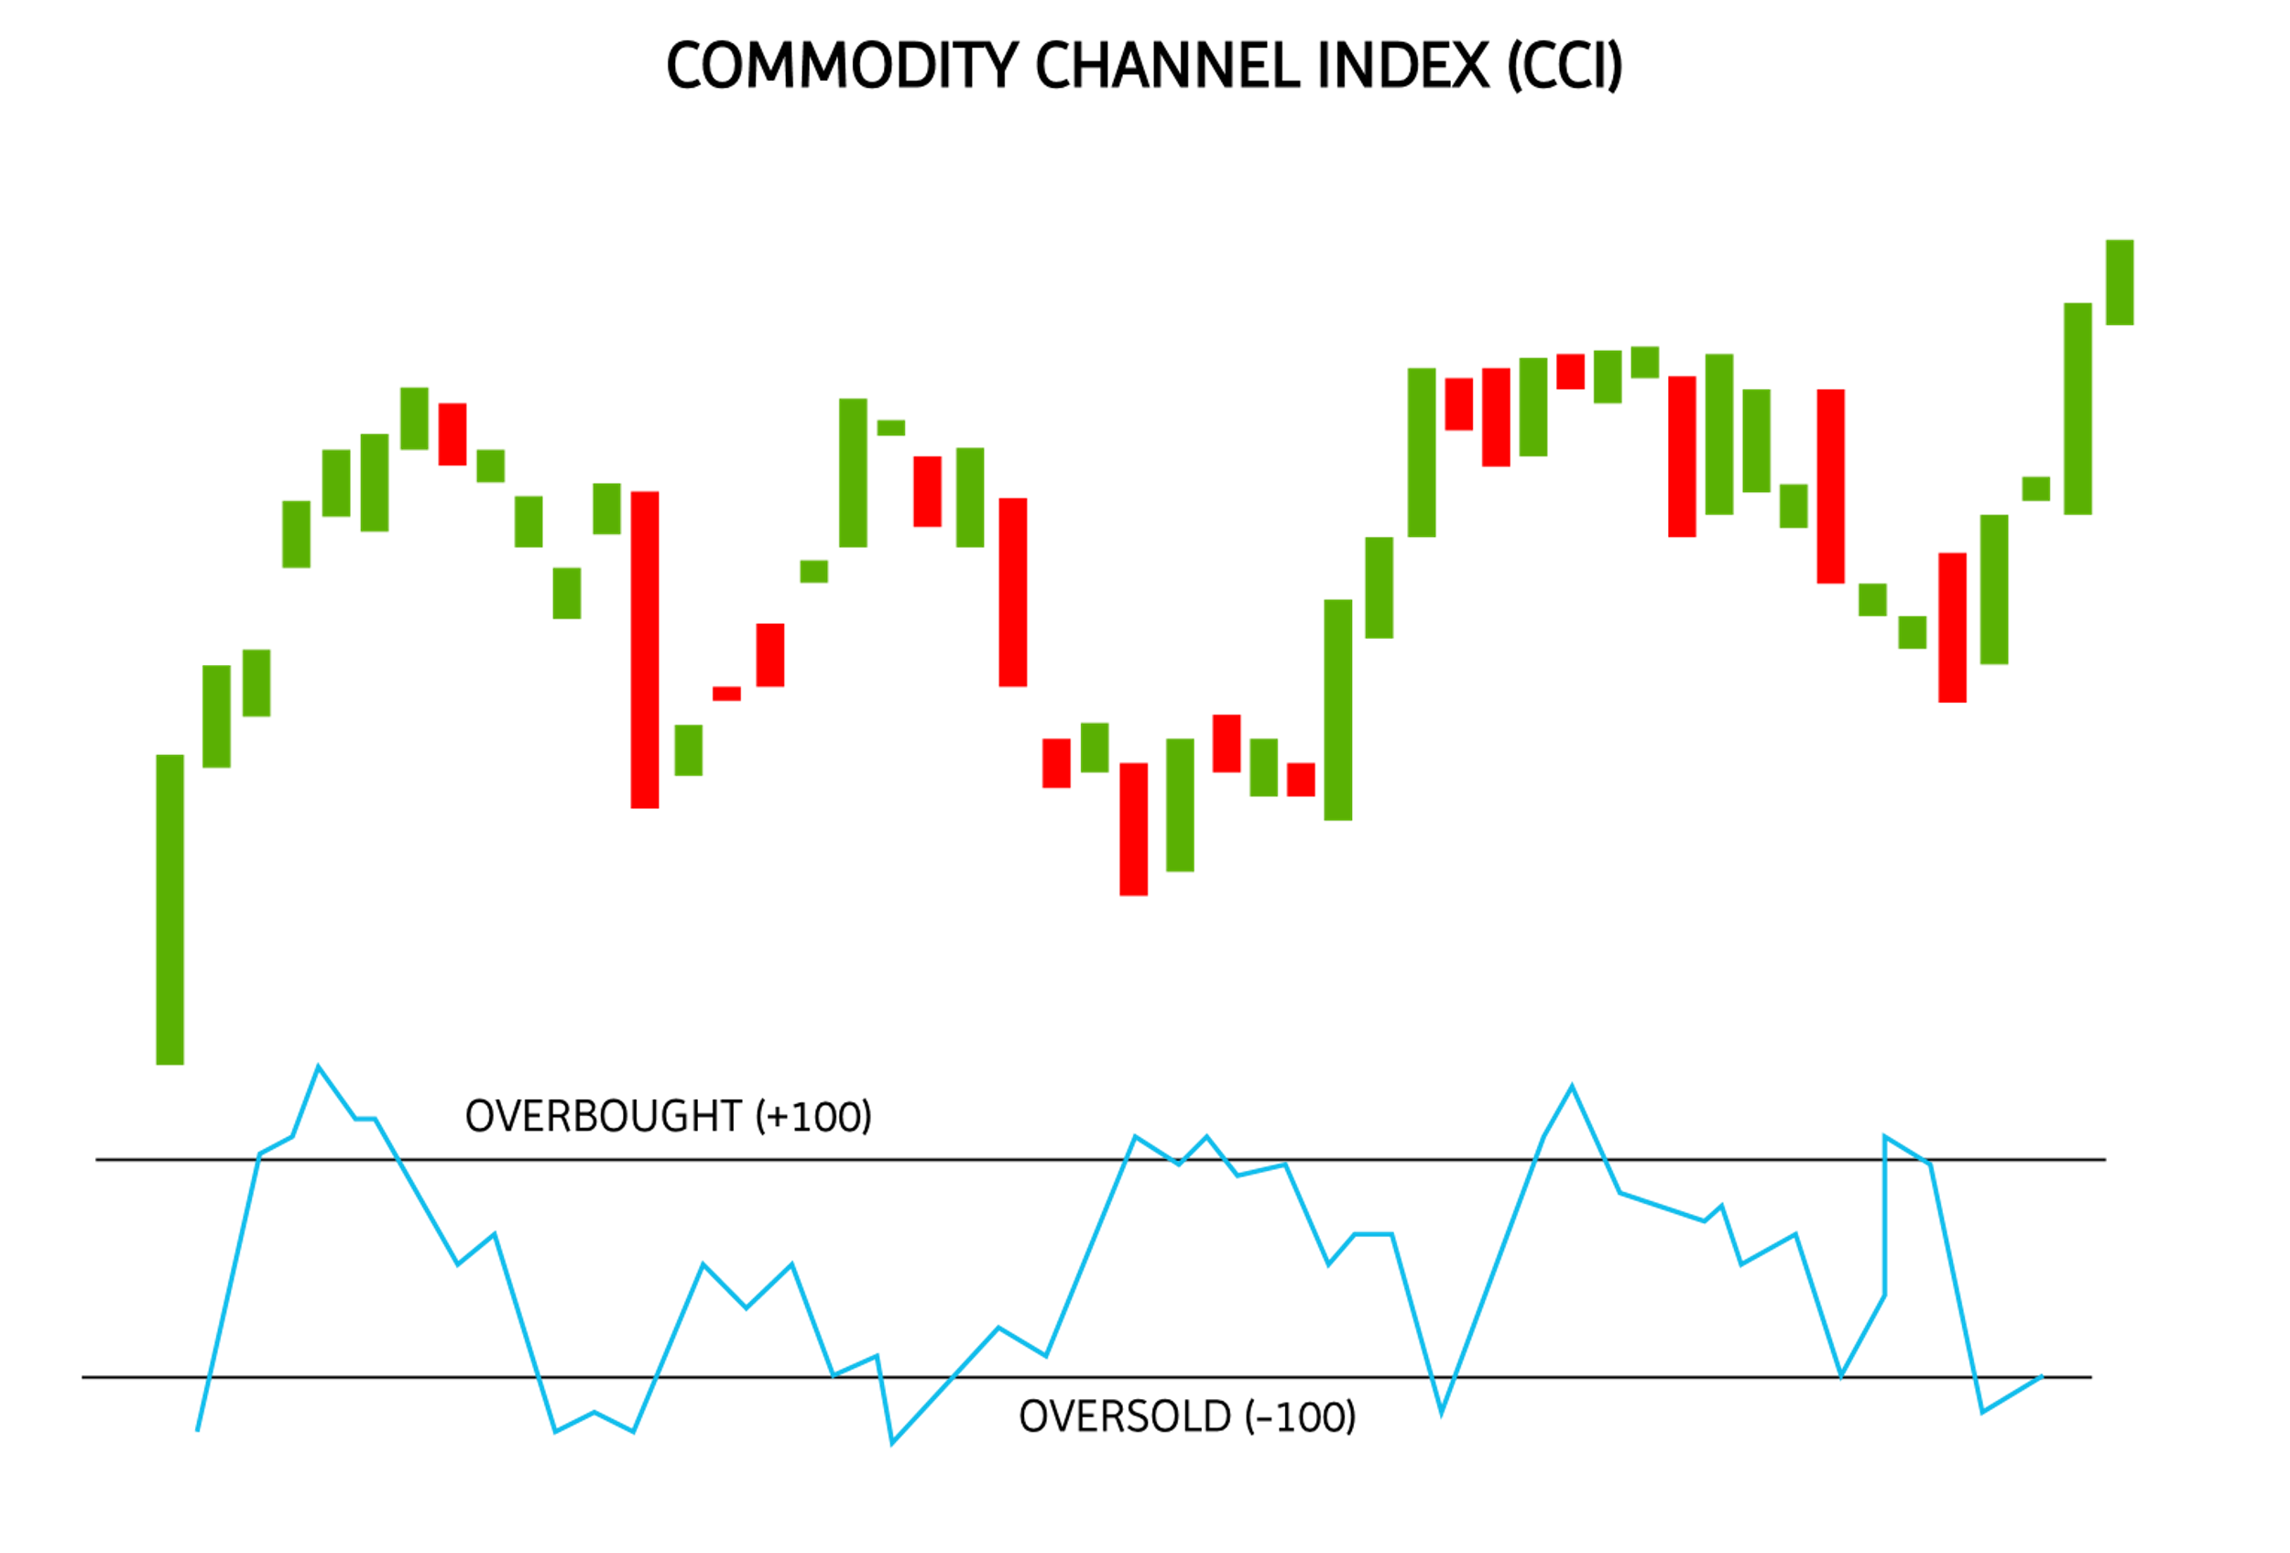
Commodity channel index (CCI)
A scaled oscillator
Measures the deviation of the price from its statistical mean
The asset has strong up or down trend when the CCI value is above +100 or below –100
Above 100 is a buy signal, under –100 is a sell signal
Up-trend bound
Down-trend bound

Slide 8
Our momentum strategy: CCI + ICHI
Ichmoku contains a total of five indicators, KS\TS\SSA\SSB\Lagging Span
A way of combining momentum indicators and trend recognition indicators
when the price crosses the cloud it indicates buy or sell signals. Ichimoku cloud provides trend direction and reversal signals.
CCI provides the confirmation
In combination you can selectively trade to ensure alignment of trades are aligned with the main trend, which significantly improves the accuracy of our trades
Buy and sell signals are judged through ICHI
CCI confirms that the signals are correct

Slide 9
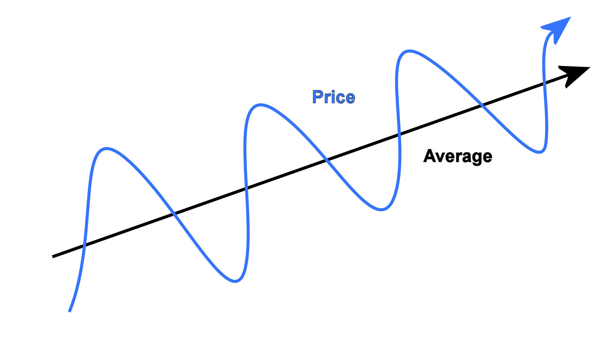
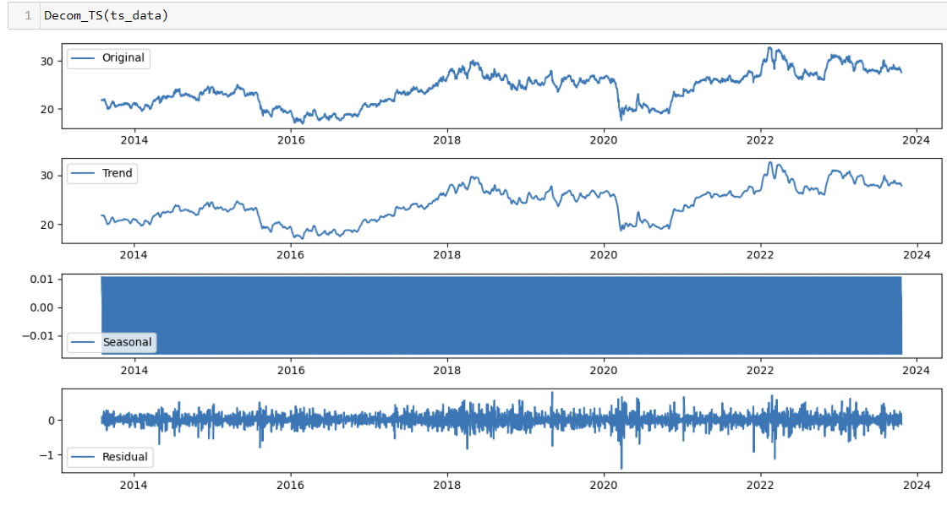
Mean reversion
The price of a stock should always fluctuate around the mean
High performing stocks will eventually fall back to their average, so we sell them
Low performing stocks will grow back to their mean, so we want to buy
In terms of mean reversion strategy we analyzed TP indicator, performed a TS decomposition and Spectrum Analysis Back Projecstion
Assumption:
mean reversion strategy has net predictive power for some stocks

Slide 10
Our mean reversion strategy
First, we selected several typical mean reversion indicators, (TP, SMA_TP, MD, CCI, TS, KS, SSA, SSB, LS, intercept) are our representative indicators.
We selected TP, TS, SSA as our model indicators by performing OLS regression on these indicators, where typical price – TP – was taken as an average of high, low and close price
TP is often used to represent the "typical" price of an asset.

Slide 11
OLS on indicators
Assumption:
Chosen variables satisfy OLS’ 5 assumptions
TS (Time Series Analysis): a methodology used to analyze time series data and can be used to examine historical trends and patterns in prices to determine whether prices are deviating from their mean values
TP In a mean reversion strategy, TP is often used to represent the "typical" price of an asset.
SSB (Singular Spectrum Analysis Back Projection): SSB may be used to reduce the major cyclical components of time series data, thus helping to identify cyclical price movements.
Main reason to choose the above: they have the highest contribution to the final closing price (CLOSE) through statistical tests
Assumption:
TP, TS and SSA will continue to have high predictive power for every stock’s price
Notes:
Looking at the OLS summary for UOB alone, we can see that it has low p-value for F test, so it’s good overall model.
We can see that the p-value of TP, TS and SSA are small. We can choose to use this to for the mean reversion strategy.

Slide 12
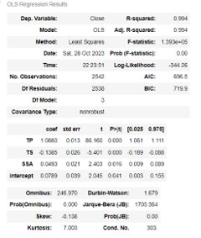
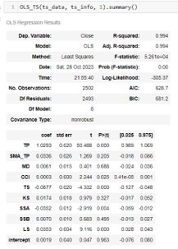
OLS on indicators: outcomes
Adjusted R square is used to assess the goodness of linear fit, his value range is (0, 1), the closer to 1 means that our fit is better.
At the same time we can see that prob(f) is the P-value of the F-statistic, if the value of prob(F) is very small (usually less than the level of significance, for example, 0.05), it indicates that the F-statistic is significant, and can reject the null hypothesis which means the fit of the predictor variables to the model is significant.

Slide 13
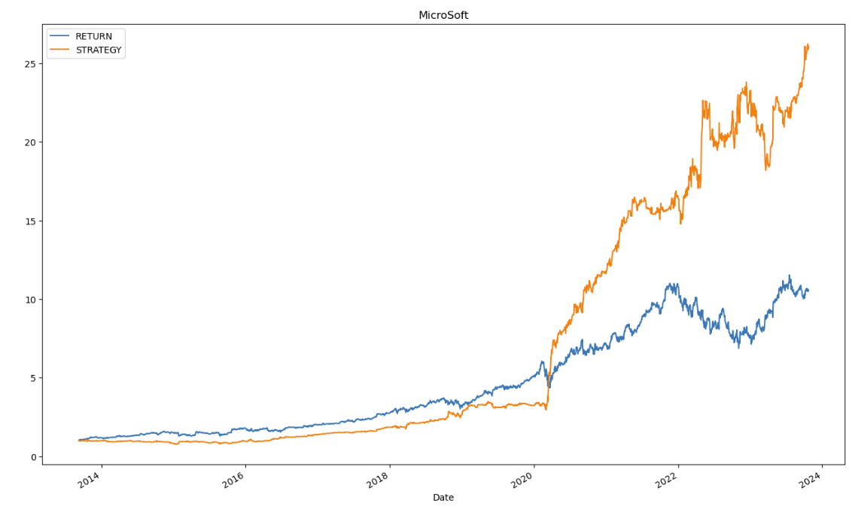
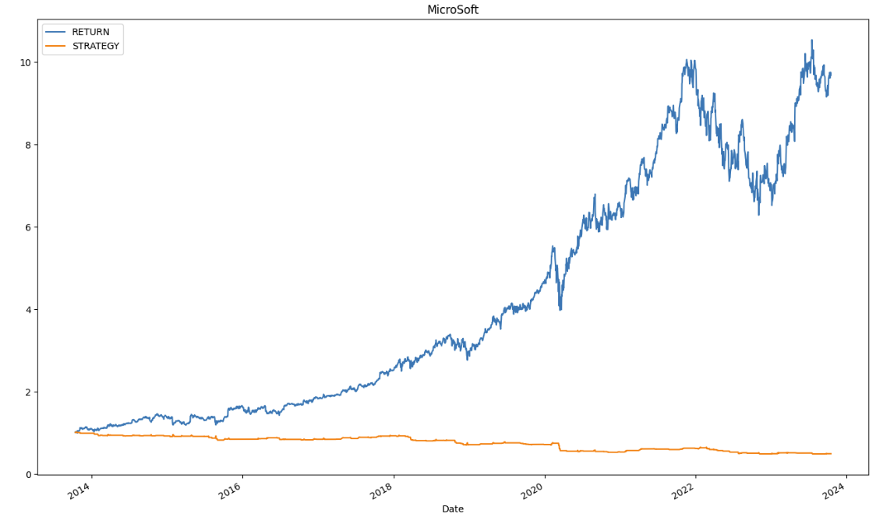
Sample graphs of MSFT strategy returns
Mean reversion
Momentum

Slide 14
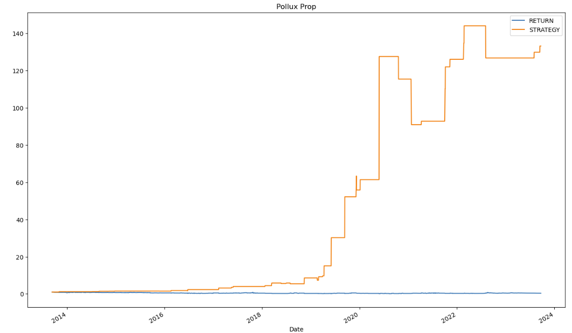
Data cleaning
Many companies from SND are not eligible for the strategy, because their market cap is too small.
We have thus removed them from further consideration

Slide 15
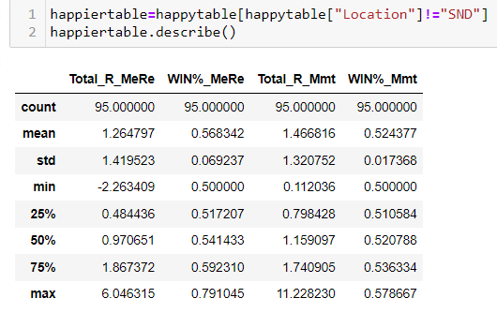
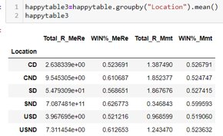
Outcome summary
We have a positive return for most of the sampled stocks
We have a positive win rate or prediction rate for most of the sampled stocks

Slide 16
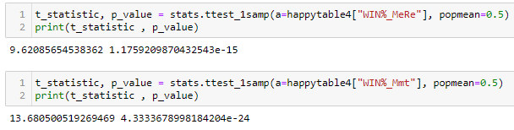
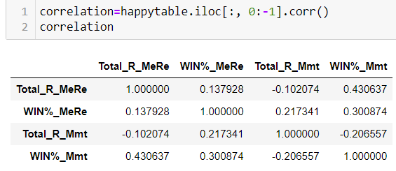
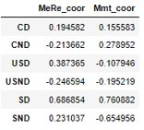
Analysis on the results
a statistical test was conducted to test whether the results obtained could have been a coincidence and mere luck
This hypothesis was rejected – our p-value is small, and thus the results are reliable and based on our strategy
No clear correlation between the win% and return, unless we group them by stock type

Slide 17
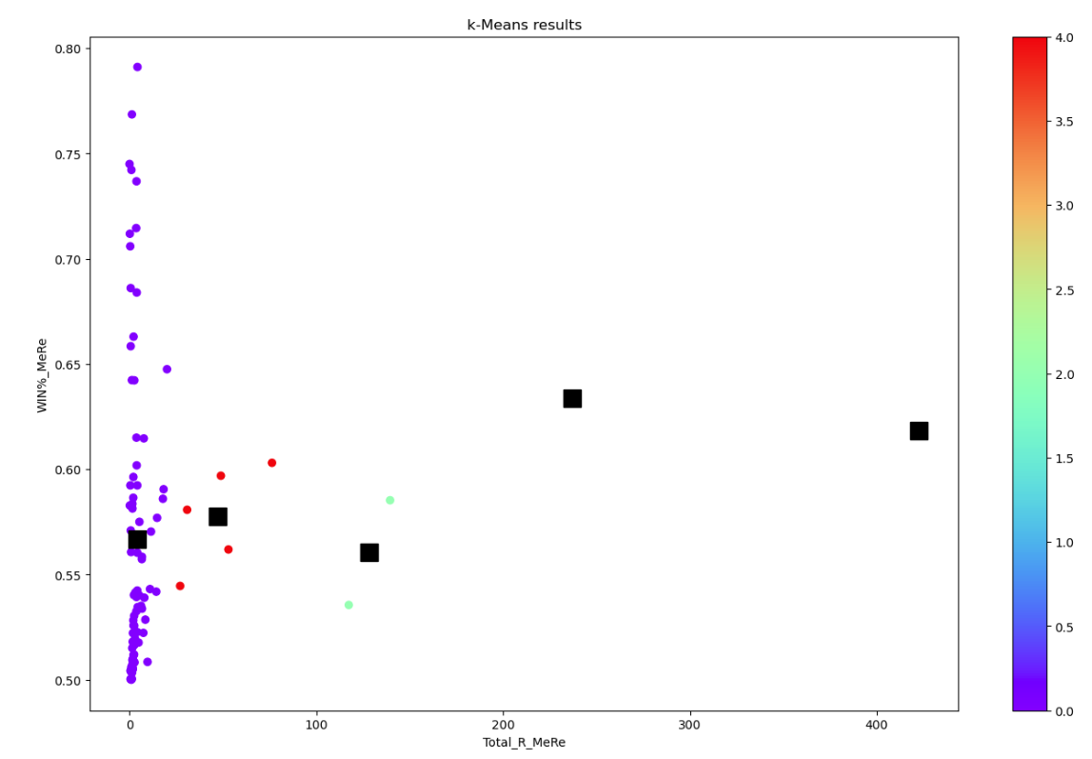
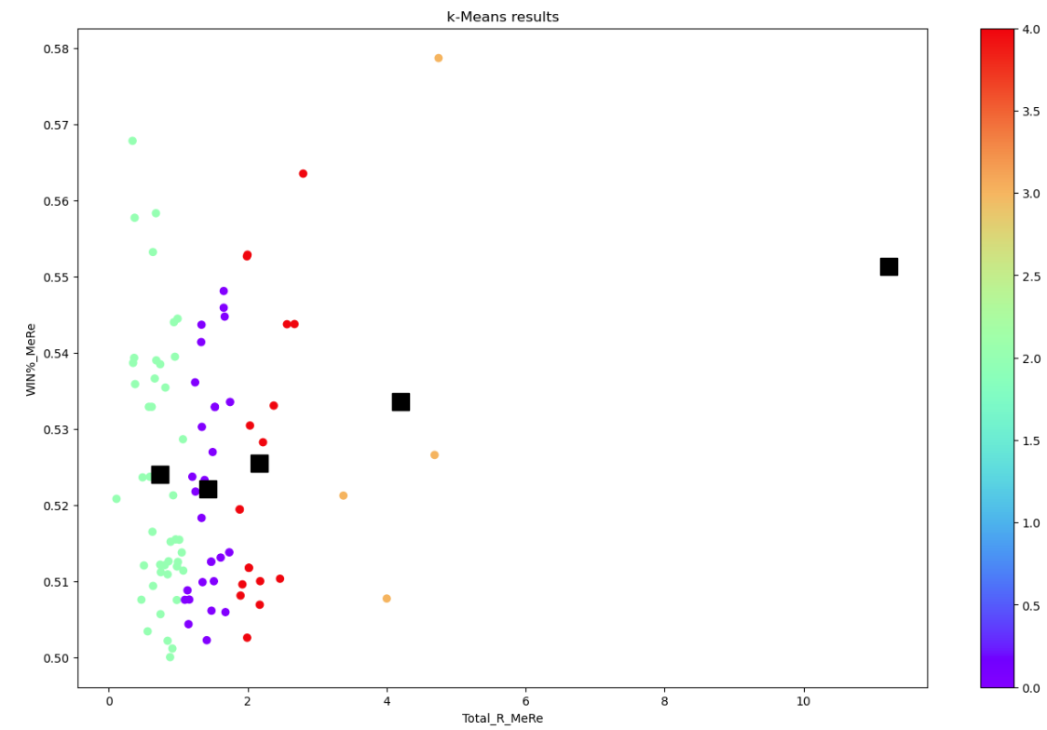
Analysis on the results
Conclusion: most of the stocks give us minimal return, and the win% varies widely.
There are a few stocks giving us high return and decent win%: UMS (SD), YZJ Shipbldg(SD), ThaiBev(SD), Seatrium (SD), ComfortDelGro(SD), Sembcorp(SD), SMIC(CND), MSFT(USD), NVDA(USND)
It appears that our mean-reversion strategy is more suitable for SD stocks
Conclusion: most of the stocks gives us minimal return, and the win% varies widely.
There’s a few stocks giving us high return and decent win%, they are:NIO(CND), BYD(CND), TSLA(USND), MRNA(USND), UMS(SD)
It appears that our momentum strategy is somehow more suitable for car stocks

Slide 18
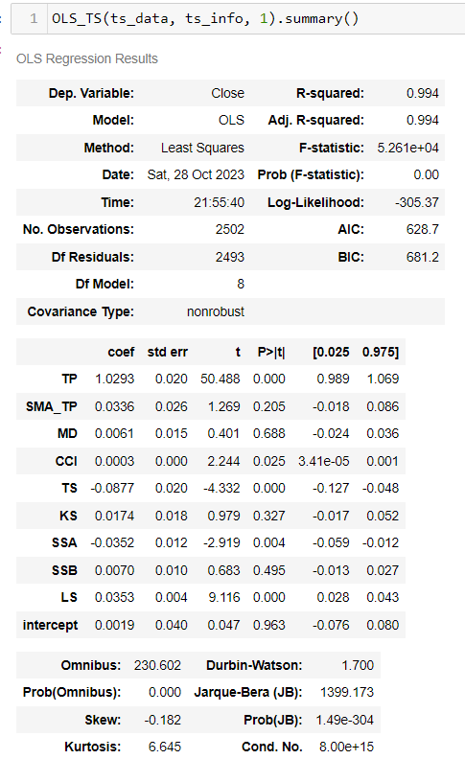
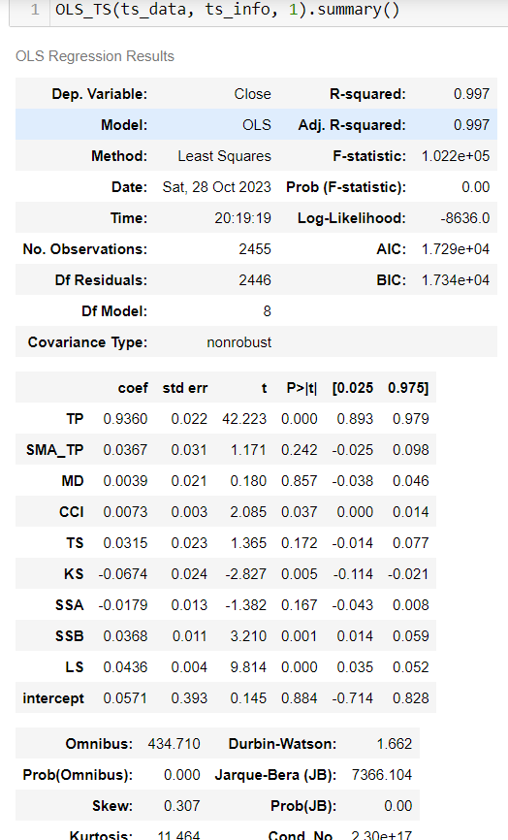
Discussion on limitation
Unsure whether the strategy would continue to work well for the highlighted types of stocks
Further refinements should be explored and tested
Choice of independent variable for Mean-reversion strategy is somewhat arbitrary and may not be replicable
Investors would compare against a different investment, rather than against saving in the bank
How much money do we invest? What about MDD? And Risk?
UOB
QQ
Notes:
For the readings below, we can see that omnibus, kurtosis and JB all shows that we have outlier issue. This should be mitigated by taking log on both the independent and dependent variables, but somehow when we conduct the test, it has no effect.
Additionally, we noticed that the t value of PT is a little high. However, despite our attempt at domain knowledge, there’s no clear interaction variable we can use to further reduce it.
The Conditional number is also quite high. This means there’s collinearity present, and can be mitigated by dropping one of the collinear variables or by taking a ratio.
(On the right)
We also tested whether TP, TS and SSA are still the best independent variables for the mean-reversion prediction. Unfortunately, as shown when testing with QQ, the best independent variables has changed to TP, CCI and KS. This shows a limitation of our model.

Slide 19

Future development of our strategy
Find out why some stocks are more or less suitable for our strategy
Define better strategy's effective range
Consider further use of time-series decomposition
Hyper-parameter tuning
A more rigorous method for determining mean-reversion indicator
Compare against CAPM or risk-free rate
Risk/reward & money management

Slide 20

Thank you for your attention, please feel free to ask any questions!

